Slide 1

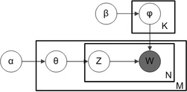
Latent Dirichlet Allocation (LDA)

Slide 2
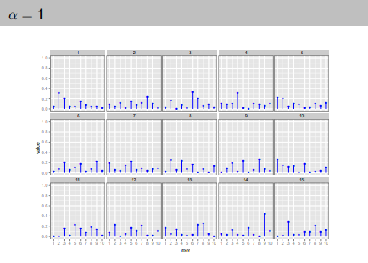
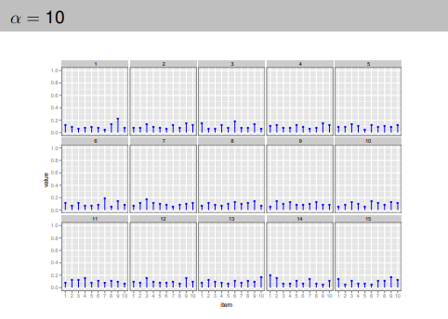
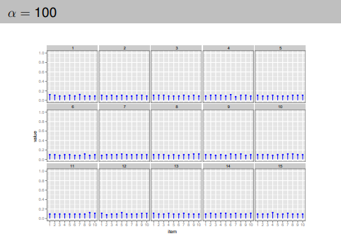
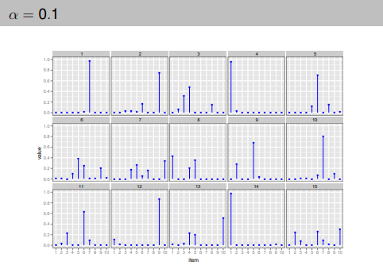
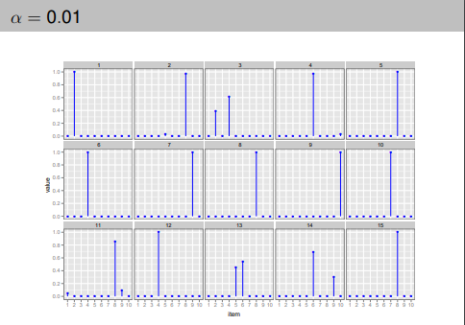

Slide 3
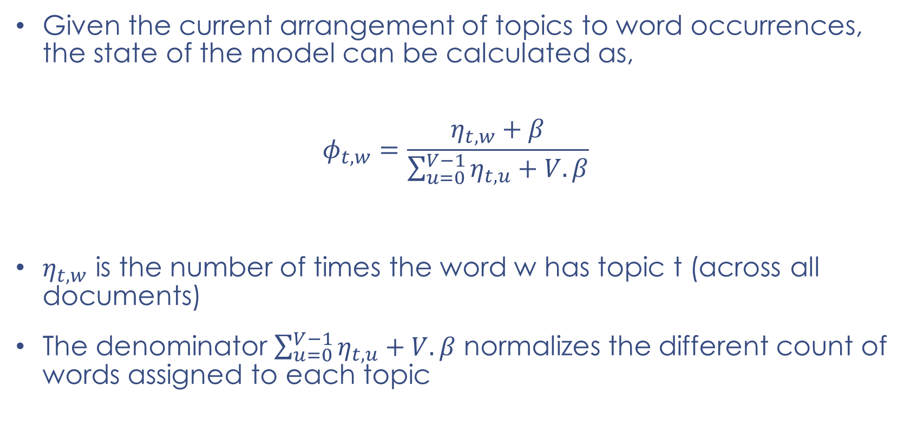
Model State ($θ$ and $φ$)
Given the current arrangement of topics to word occurrences, the state of the model can be calculated as,
$$φ_{t,w}=\frac{η_{t,w}+β}{\sum_{u=0}^{V−1}{η_{t,u}}+V.β}$$
$η_{t,w}$ is the number of times the word w has topic t (across all documents)
The denominator $\sum_{u=0}^{V−1}{η_{t,u}}+V.β$ normalizes the different count of words assigned to each topic

Slide 4



Model State ($θ$ and $φ$)
$θ$ is a D x T matrix, $φ$ is a T x V matrix
A single value $θ$ i.e., $θ$_{d,t} = $θ$_{2,0} can be calculated as,
$$θ_{2,0}=\frac{η_{2,0}+α}{\sum_{k=0}^{T−1}{η_{2,k}}+T.α}$$
Model State ($θ$ and $φ$)
A single value$φ$ i.e.,$φ$_{t,w} =$φ$_{0,2} can be calculated as,
$$φ_{0,2}=\frac{η_{0,2}+β}{\sum_{u=0}^{V−1}{η_{0,u}}+V.β}$$

